Slide 1


Enhancing Customer Satisfaction through Advanced Classification Models
Subtitle: Data Mining Assignment - Group Presentation
Group Members:
Advika kavya Parlakoti-20003401
Satya Kishore Reddy Duvvi-10639744
Pradyumna Shivanandaiah-20006386
Date: November 3, 2023
Course: Data Mining - B9BA103
Colab: Click Here

Slide 2

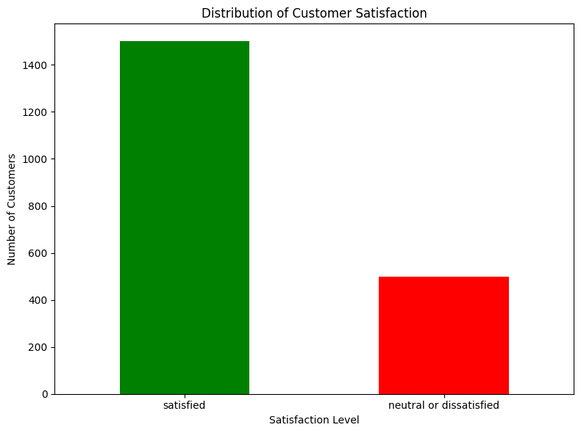
Introduction to Business Problem Maximizing Airline Customer Satisfaction
Challenge: In the competitive airline industry, customer satisfaction is a key differentiator that drives loyalty and revenue.
Objective: To leverage data mining techniques to predict customer satisfaction levels and uncover factors that influence positive experiences.
Dataset Insight: Utilized a dataset with over 2000 samples, encompassing features such as age, gender, customer type, travel class, flight distance, and service ratings.
Goal: The ultimate goal is to build a robust classification model that can accurately classify customers as 'satisfied' or 'neutral/dissatisfied', enabling the airline to tailor services and improve overall customer experience.

Slide 3
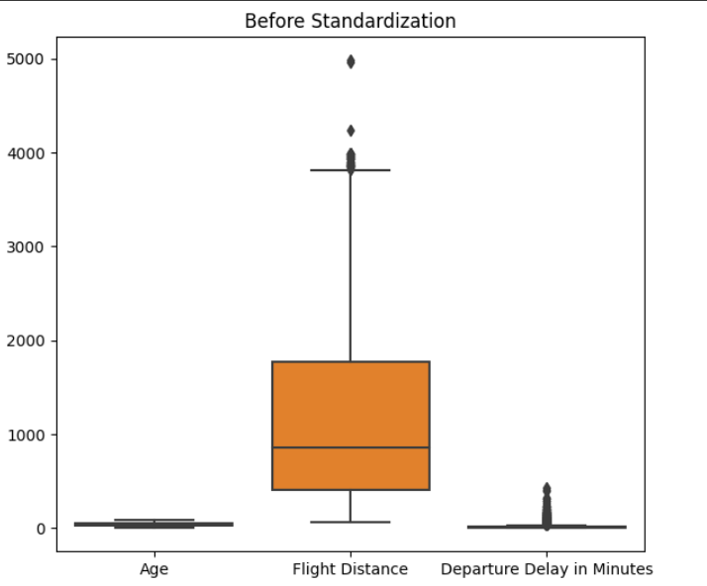
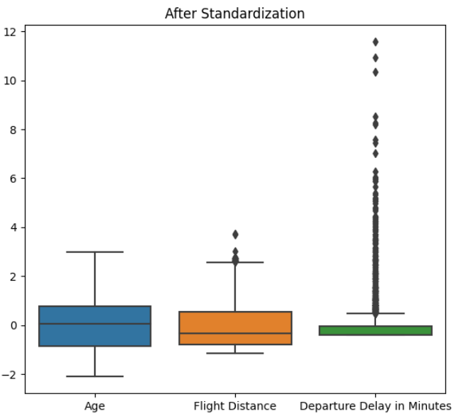
Data Quality in Context of Business Objectives
Data Integrity: Over 2000 entries with 10+ variables, prepped for predictive modeling.
Missing Values: Mean imputation applied to numerical fields to maintain dataset completeness.
Categorical Encoding: Conversion of categorical to numerical to facilitate model ingestion.
Feature Standardization: Standardized numerical features to neutralize scale biases.
Relevance to Business Problem: Dataset features selected to directly influence customer satisfaction prediction.

Slide 4
Model Performance Evaluation Criteria
Evaluation Metrics Explained:
Our model assessment relies on accuracy, precision, recall, F1 score, and ROC AUC to ensure a comprehensive evaluation.
Accuracy measures overall correctness, precision focuses on the reliability of positive predictions, recall assesses the model's ability to identify all relevant cases, F1 score provides a balance between precision and recall, and ROC AUC reflects performance across all classification thresholds.
Business Impact of Prediction Errors:
False Positives (predicting satisfaction incorrectly): May lead to complacency in service improvement, risking future customer loyalty and revenue.
False Negatives (missing unsatisfied customers): Critical as it may result in loss of customers and tarnish brand reputation if not addressed promptly.
Financial Implications of Model Choices:
Our analysis incorporates potential financial losses from prediction errors, emphasizing models that minimize costly mistakes.
The chosen metrics facilitate a decision-making framework that prioritizes customer retention and satisfaction, integral to long-term profitability.
Recommendation for Model Adoption:
We recommend the XGBoost model, which demonstrates the highest net benefit when considering both prediction accuracy and associated costs.
This model efficiently balances the cost of false predictions with high accuracy, proving to be the most cost-effective solution for our business needs.

Slide 5
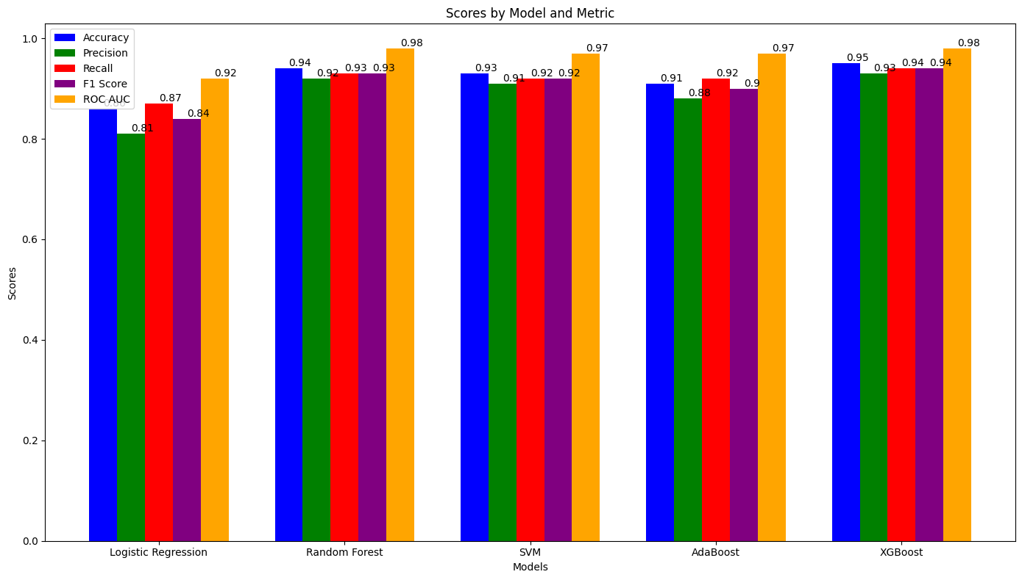
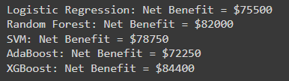
Comparative Analysis of Model Performances
Model Overview: Evaluated models: Logistic Regression (LR), Random Forest (RF), Support Vector Machine (SVM), AdaBoost, and XGBoost. Objective: Select the optimal model for predicting airline customer satisfaction.
Performance Metrics Summary: Metrics include Accuracy, Precision, Recall, F1 Score, and ROC AUC. These metrics provide a holistic view of model performance.
Numerical Performance Comparison: LR: Acc: 86%, Prec: 81%, Recall: 87%, F1: 84%, ROC AUC: 92% RF: Acc: 94%, Prec: 92%, Recall: 93%, F1: 93%, ROC AUC: 98% SVM: Acc: 93%, Prec: 91%, Recall: 92%, F1: 92%, ROC AUC: 97% AdaBoost: Acc: 91%, Prec: 88%, Recall: 92%, F1: 90%, ROC AUC: 97% XGBoost: Acc: 95%, Prec: 93%, Recall: 94%, F1: 94%, ROC AUC: 98%
Trade-offs & Selection: LR is less complex, providing ease of interpretation but lower performance. RF and SVM offer high precision but require complex tuning. AdaBoost is less sensitive to overfitting but may be affected by noisy data. XGBoost offers the highest performance across all metrics, indicating its superior predictive power.

Slide 6
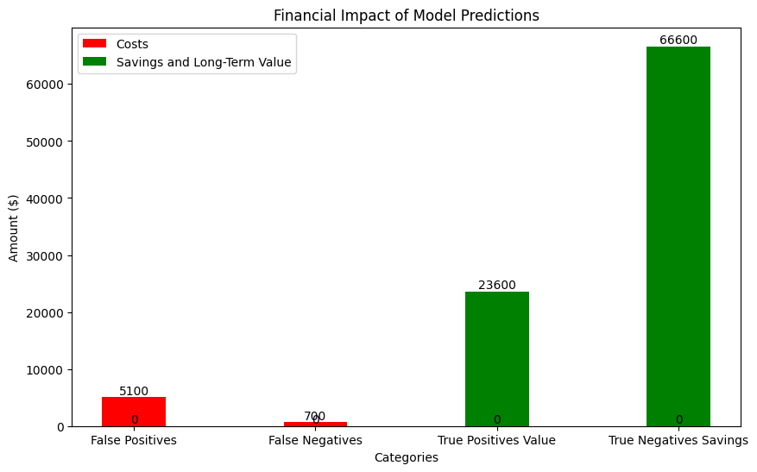
Business Impact of Model Performance
Cost Assumptions:
False Positives (FP): Predicting satisfaction incorrectly can lead to lost future business, costing an estimated $300 per incident.
False Negatives (FN): Overlooking dissatisfaction results in unnecessary appeasement efforts, costing about $50 per incident.
True Positives (TP): Accurately identifying satisfied customers has no direct cost but implies a long-term value from sustained customer loyalty, estimated at $100 over time.
True Negatives (TN): Correctly identifying dissatisfied customers provides an opportunity to rectify service, potentially saving $200 per customer.
Financial Impact Breakdown:
False Positives: 17 instances×$30017 instances×$300 = $5,100
False Negatives: 14 instances×$5014 instances×$50 = $700
True Positives: 236 instances×$100236 instances×$100 = $23,600 (long-term value)
True Negatives: 333 instances×$200333 instances×$200 = $66,600 saved
Total Expected Financial Impact:
The model's total cost due to inaccuracies: $5,100 (FP)+$700 (FN)$5,100 (FP)+$700 (FN) = $5,800.
Total potential savings and long-term value from TP and TN: $23,600 (TP long-term value)+$66,600 (TN savings)$23,600 (TP long-term value)+$66,600 (TN savings)
Strategies for Enhancing Financial Impact:
Discuss the significance of leveraging TP for long-term customer loyalty and business growth.
Emphasize the need to reduce FP and FN by enhancing the model's predictive accuracy.
Propose actionable steps such as re-training with enriched datasets, fine-tuning model parameters, or exploring alternative algorithms

Slide 7
Interpretation of the XGBoost Model's Performance
Our XGBoost model demonstrates a strong performance with an accuracy of 94%. This high level of accuracy indicates that the model is highly capable of distinguishing between satisfied and dissatisfied customers. The precision metrics are commendable, with 93% for class 0 (dissatisfied customers) and 95% for class 1 (satisfied customers), denoting that the model has a lower likelihood of false positives and false negatives, which are critical in customer satisfaction analyses.
The recall values of 97% for dissatisfied customers and 91% for satisfied customers show that the model is particularly adept at identifying those who are dissatisfied. This is essential for any interventions aimed at improving customer satisfaction. The F1 score, which is the harmonic mean of precision and recall, stands at 0.95 for dissatisfied customers and 0.93 for satisfied customers, further reinforcing the model's reliability.
The ROC AUC score of 0.99 is indicative of the model's excellent capability to discriminate between the positive and negative classes across various thresholds, which is particularly important in scenarios where the cost of false positives and negatives is high.

Slide 8
Interpretation of the XGBoost Model's Performance
Given the model's robust performance, the following recommendations are proposed:
Implementation for Customer Feedback Analysis: Integrate the XGBoost model into the customer feedback processing pipeline to accurately identify and address customer satisfaction issues.
Resource Allocation: Utilize the model's predictions to effectively allocate resources towards customers most likely to be dissatisfied, thereby potentially reducing customer churn.
Further Model Tuning: Continue to refine the model by exploring additional hyperparameter tuning, feature engineering, or even ensemble methods to further improve the recall for satisfied customers.
Business Process Adjustments: Adjust business processes based on insights gained from model predictions to enhance overall customer satisfaction and loyalty, which are crucial for long-term business success.
Cost-Benefit Analysis: Conduct a comprehensive cost-benefit analysis periodically to ensure the model continues to provide value and adjust strategies accordingly.
By following these recommendations, the business is expected to enhance its customer satisfaction levels, reduce potential revenue losses from dissatisfied customers, and ultimately, drive a more data-informed customer relationship management strategy.

Slide 9

Thank You & Questions

